Slide 1
SI NO | TOPICS | PAGE NO
1 | AWS CLI | 2
2 | EC2 | 4
3 | VPC | 15
4 | IAM, STS | 29
5 | COGNITO | 32
6 | S3 | 35
7 | ROUTE 53 | 46
8 | LAMBDA | 52
9 | CLOUDFRONT | 60
10 | SQS, SNS | 63
11 | DOCKER, ECS, ECR, EKS | 71
SI NO | TOPICS | PAGE NO
12 | ELASTIC BEANSTALK | 76
13 | CICD
14 | CLOUD FORMATION
15 | DYNAMO DB
16 | API GATEWAY
17 | RDS, ELASTIC CACHE
18
19
20
21
22

Slide 2
AWS CLI

Slide 3
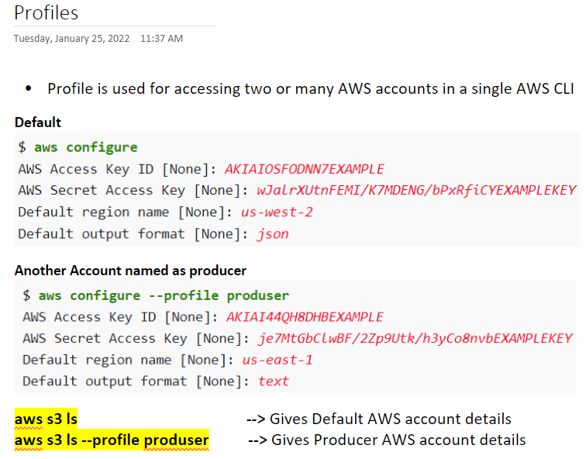

Slide 4
AWS EC2

Slide 5
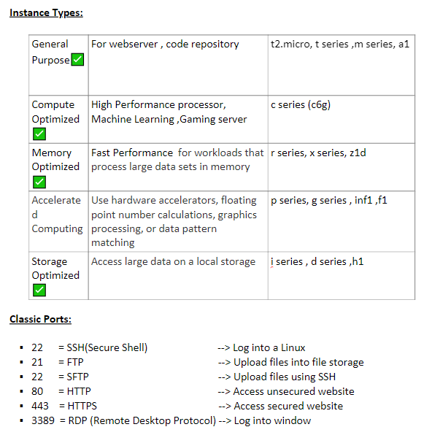

Slide 6
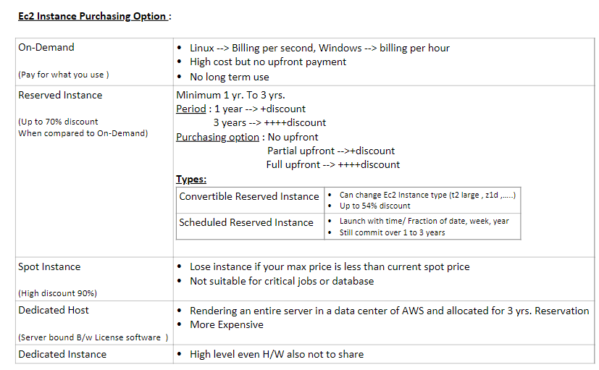

Slide 7
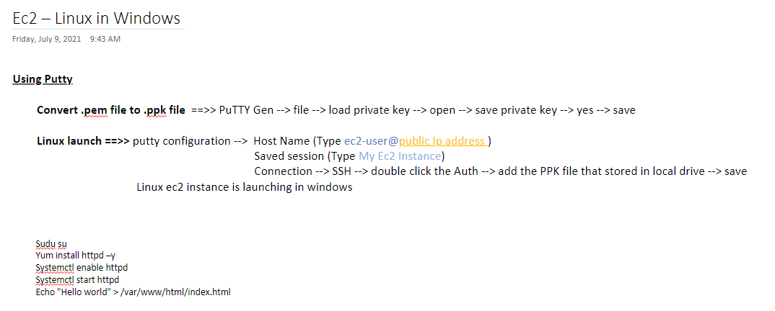
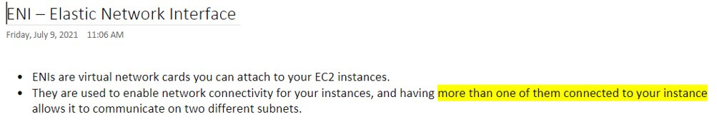

Slide 8
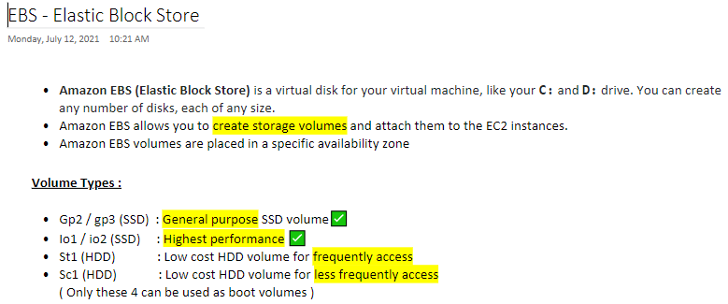
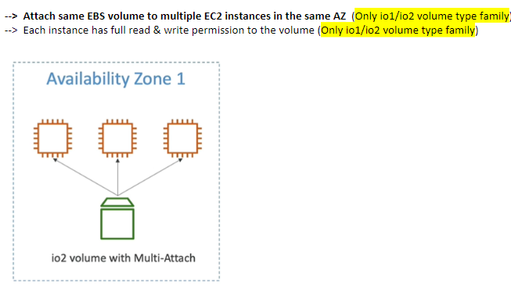

Slide 9
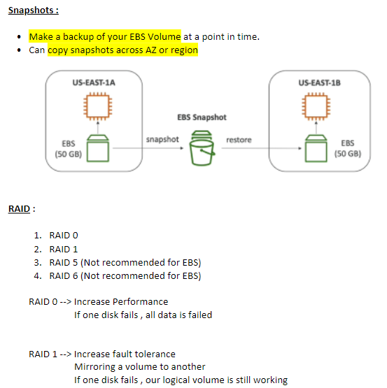

Slide 10
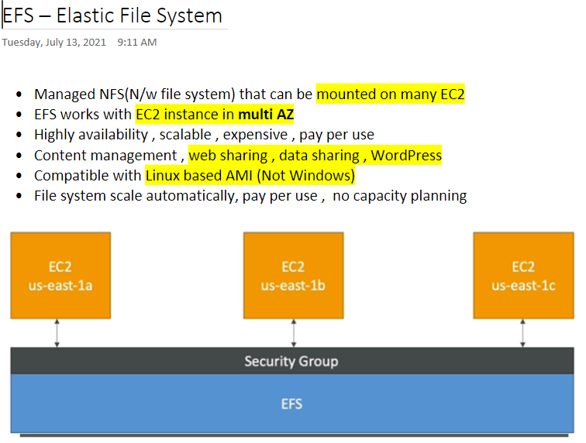
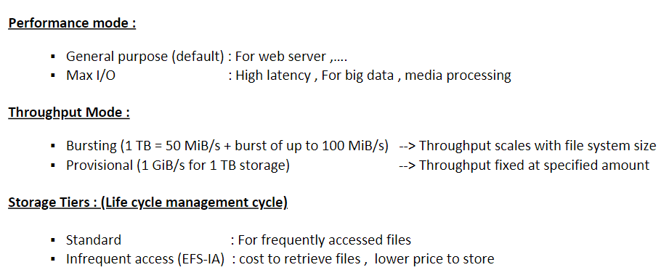

Slide 11
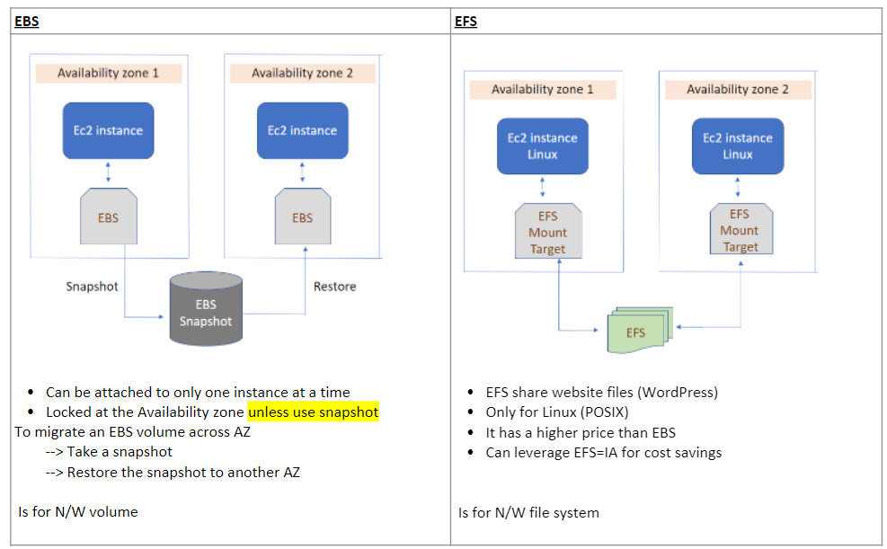

Slide 12
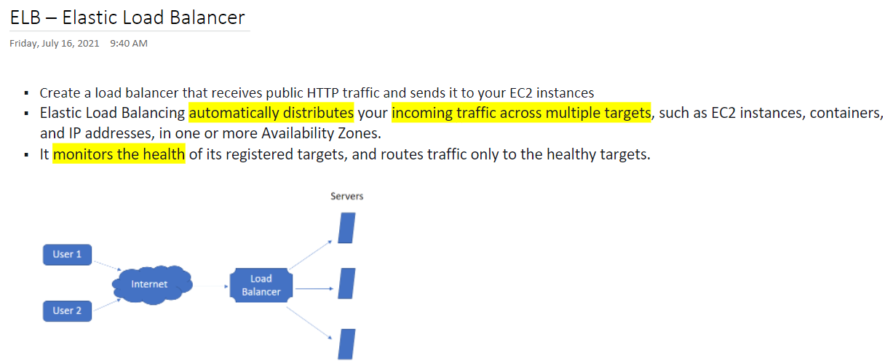
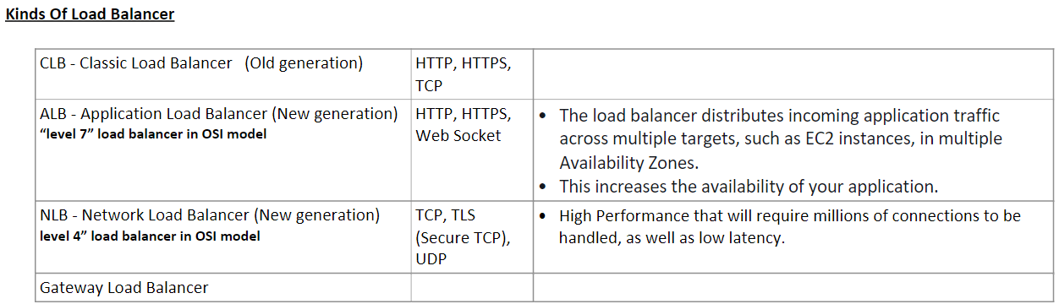

Slide 13
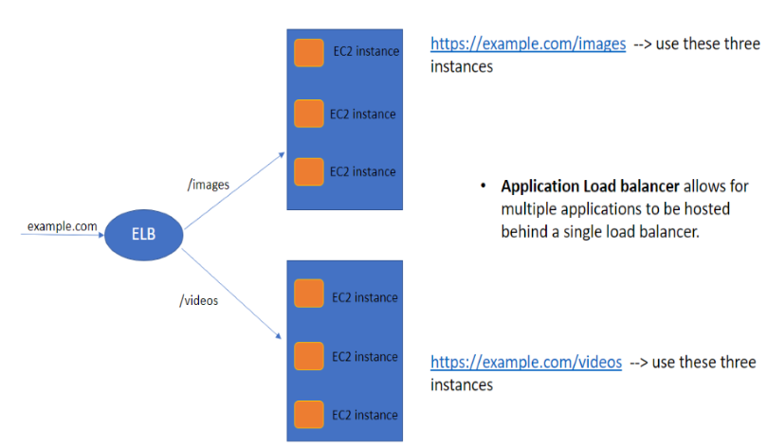
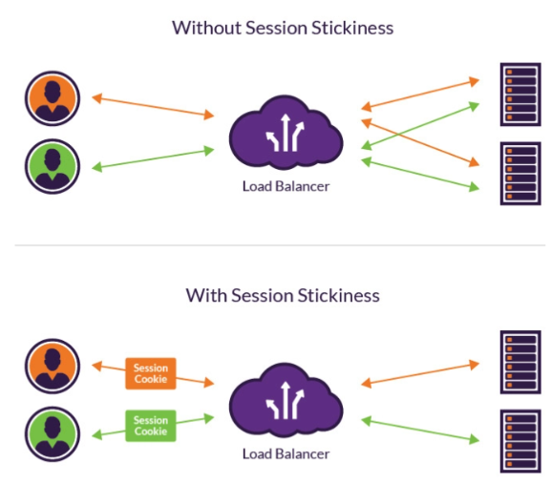

Slide 14
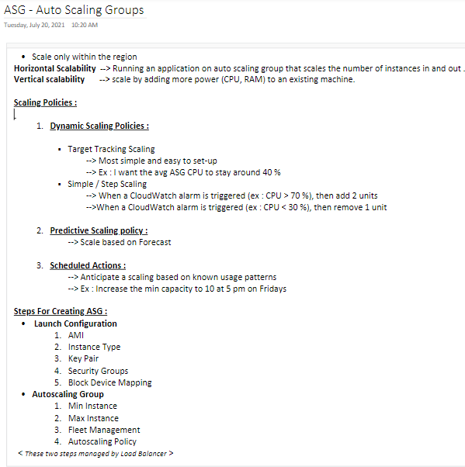

Slide 15
VPC

Slide 16
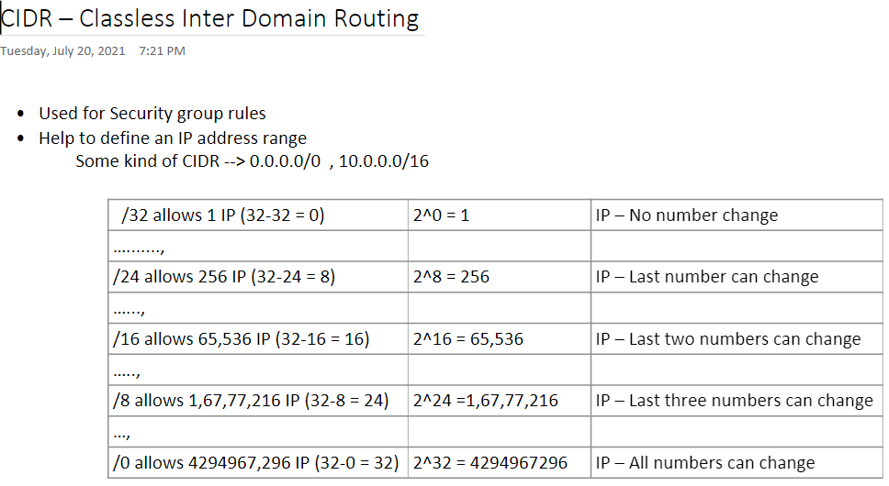

Slide 17
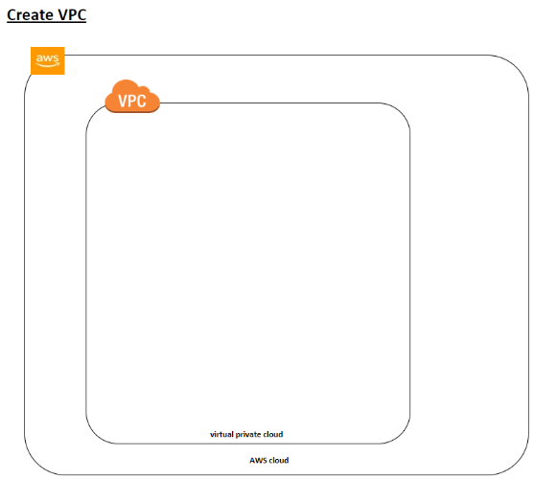
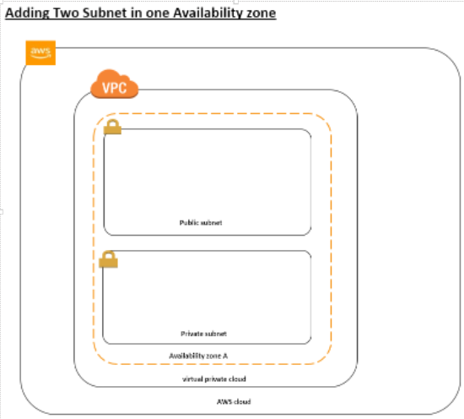

Slide 18
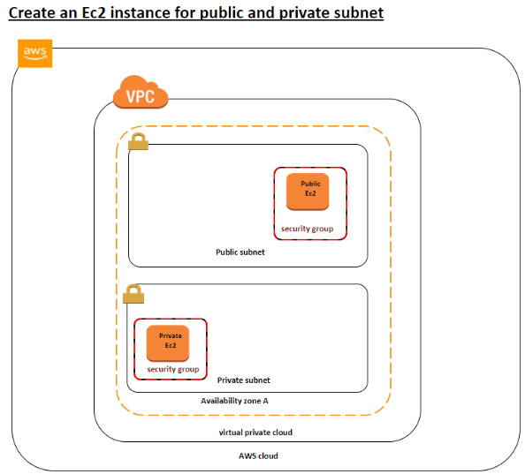
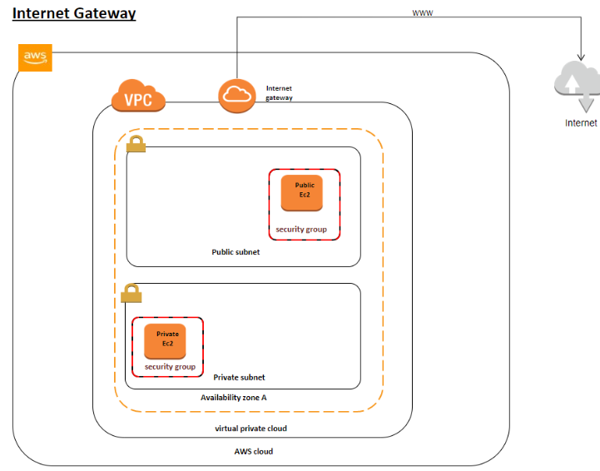

Slide 19
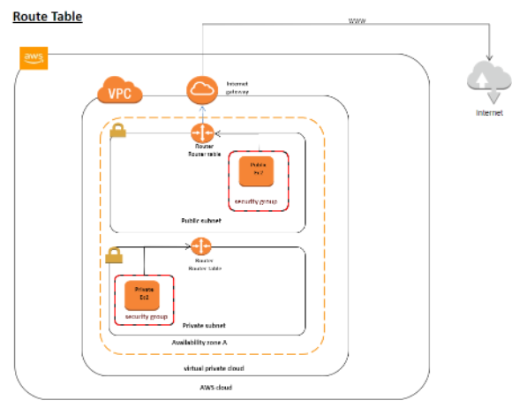
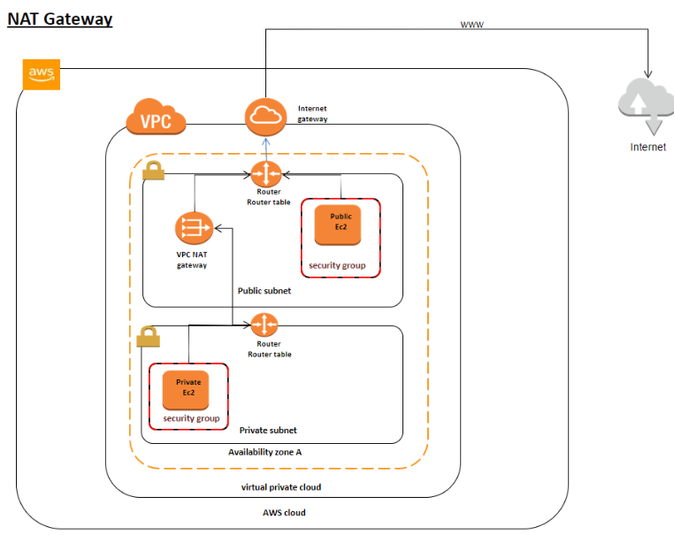

Slide 20
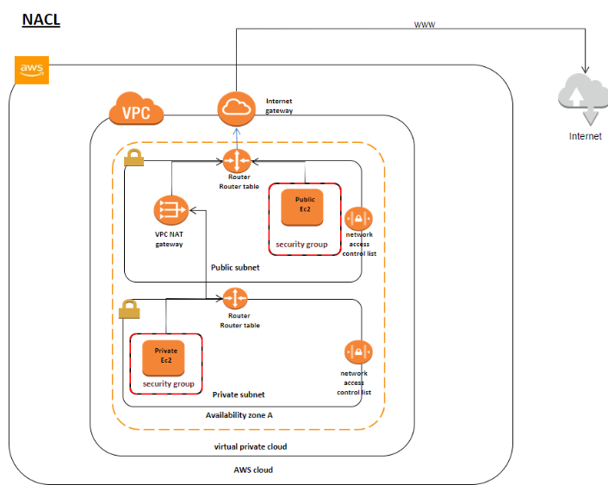
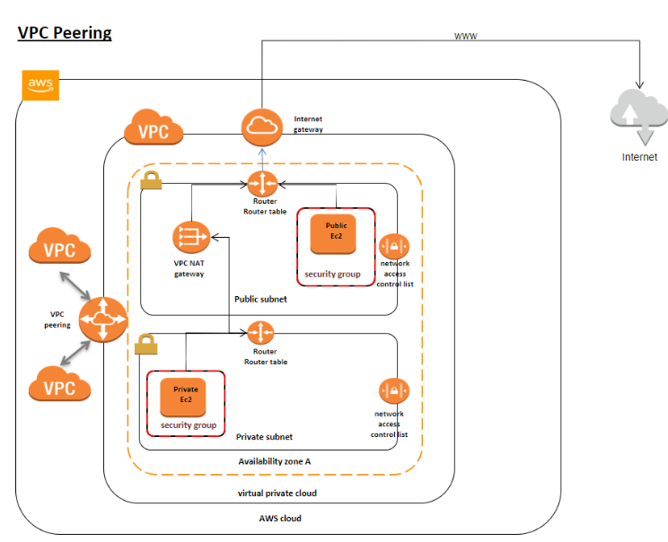

Slide 21
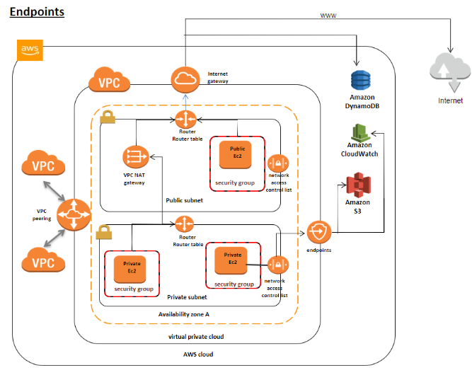
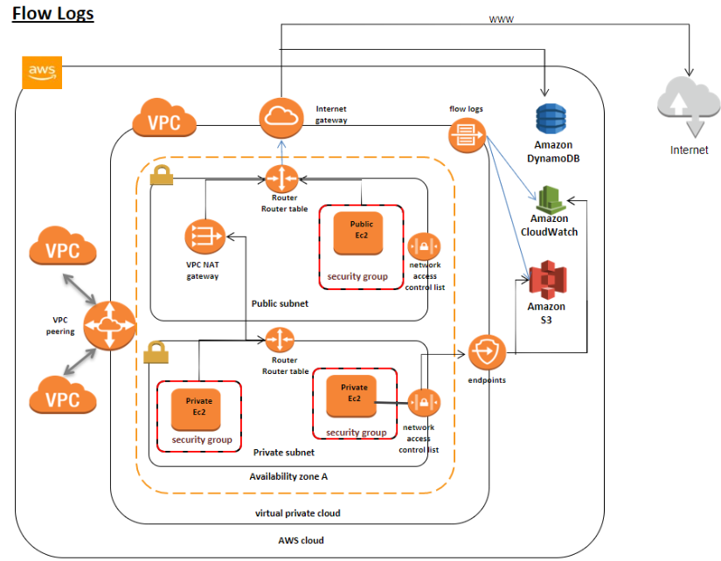

Slide 22
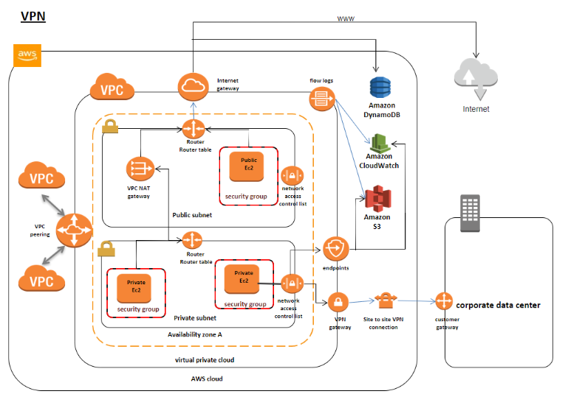

Slide 23
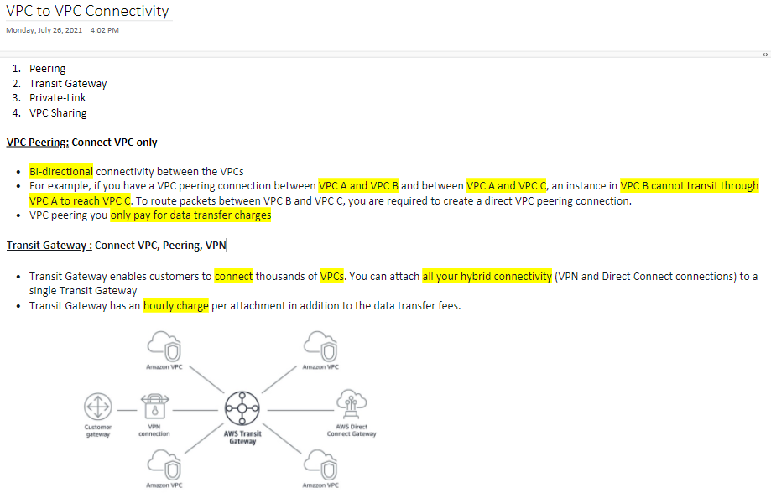

Slide 24
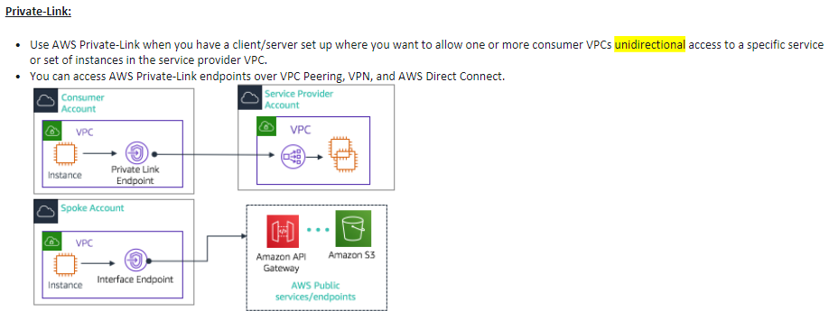

Slide 25
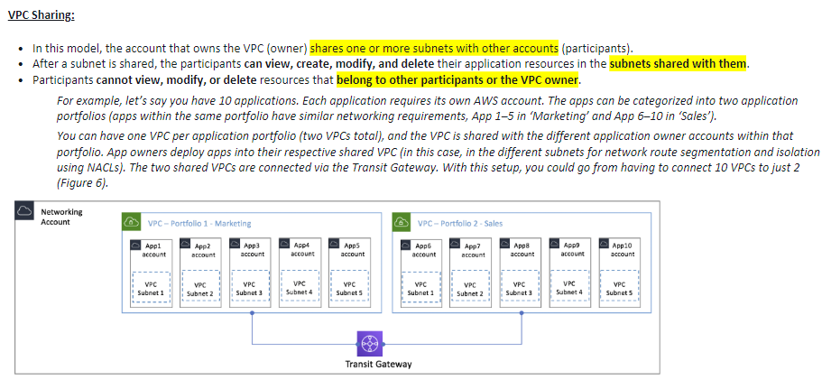

Slide 26
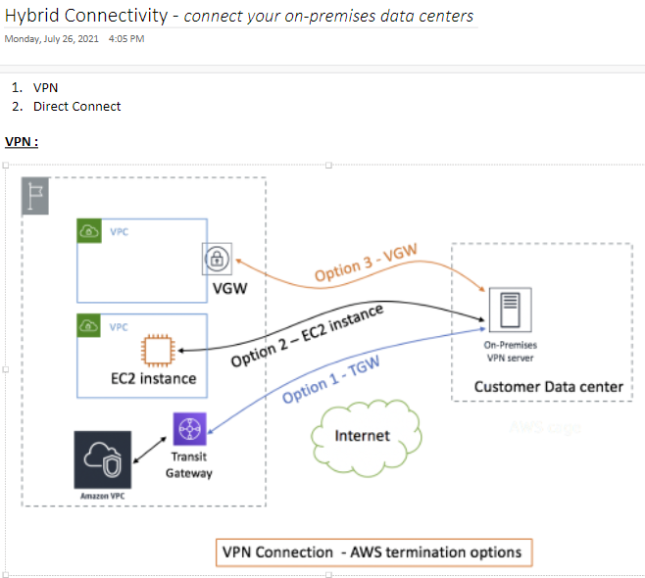

Slide 27
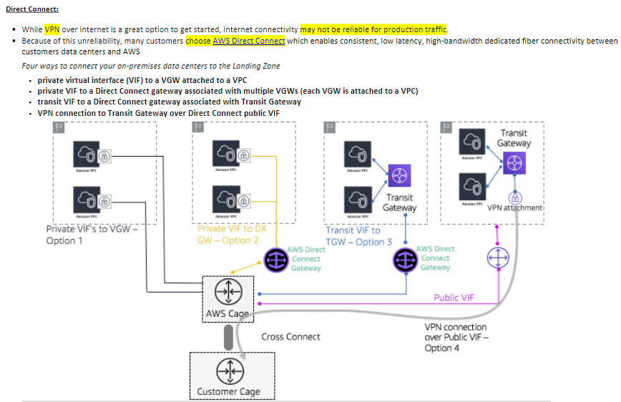

Slide 28
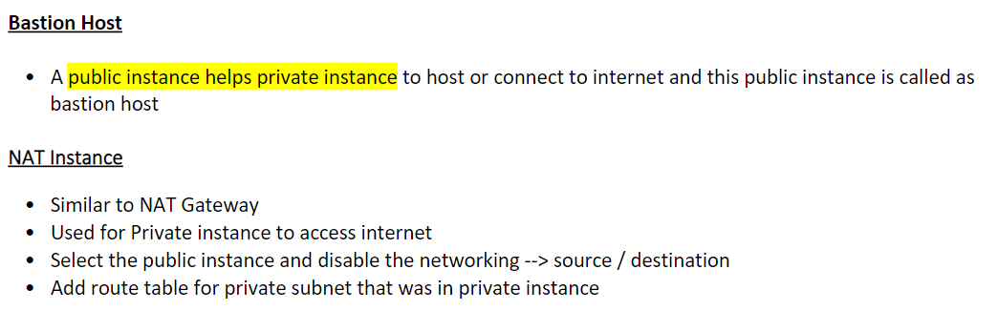

Slide 29
IAM, STS

Slide 30
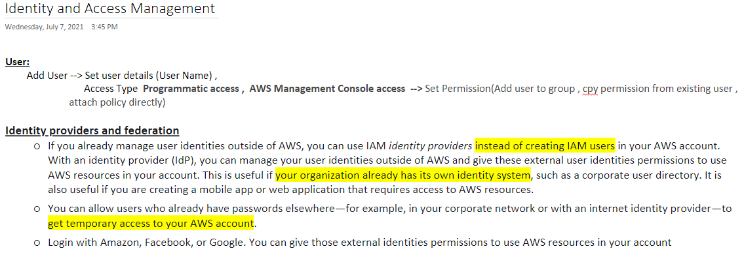

Slide 31
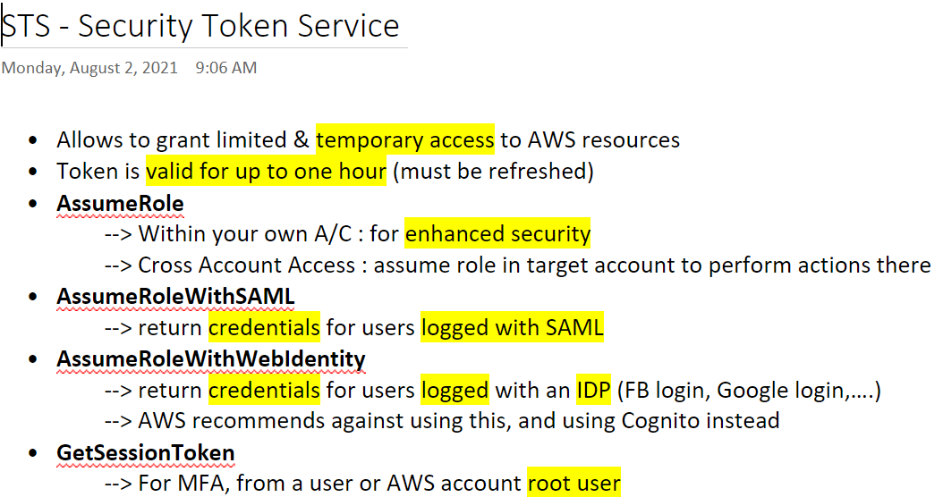

Slide 32
COGNITO

Slide 33
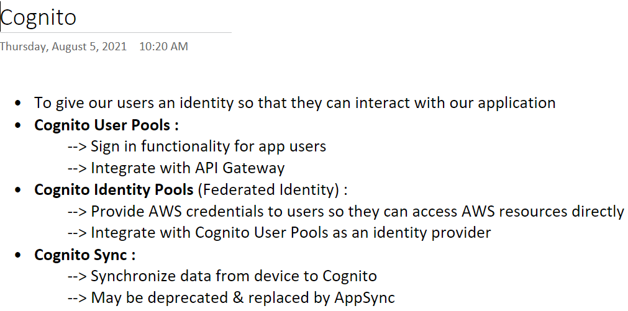
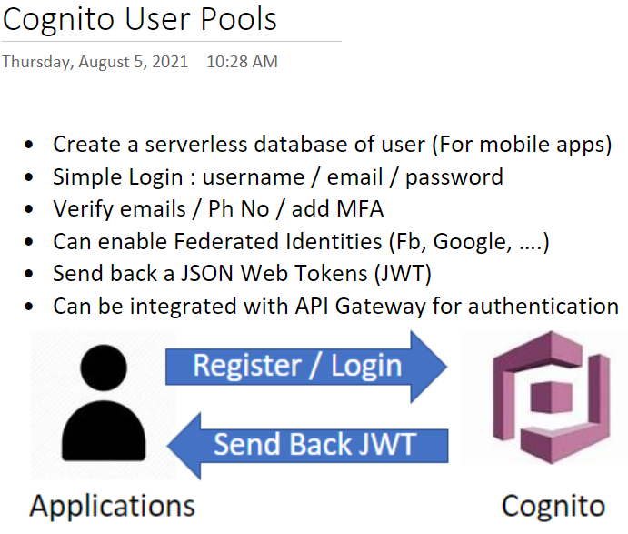

Slide 34
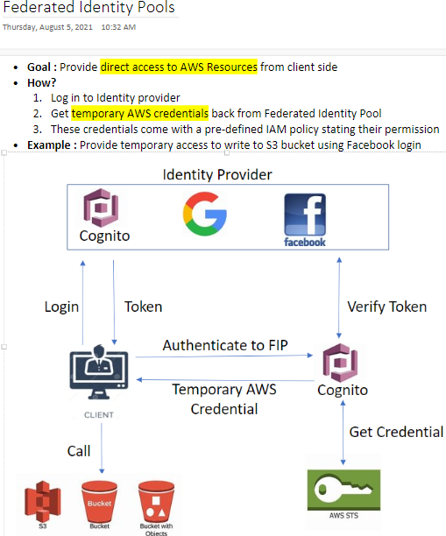

Slide 35
S3

Slide 36
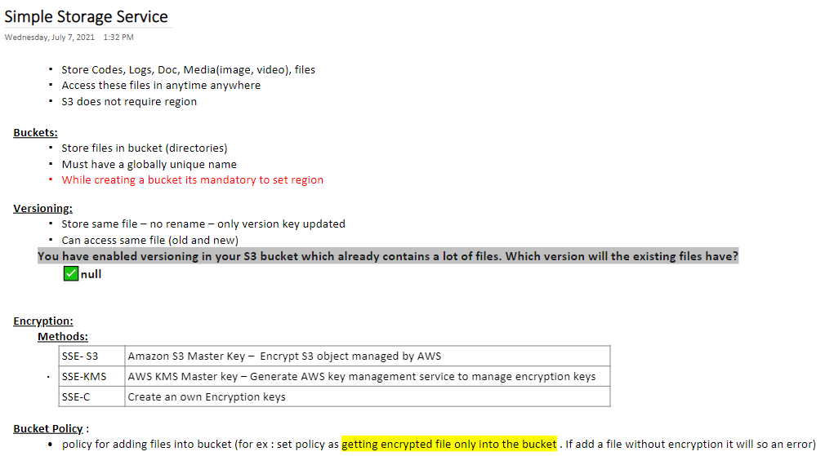

Slide 37
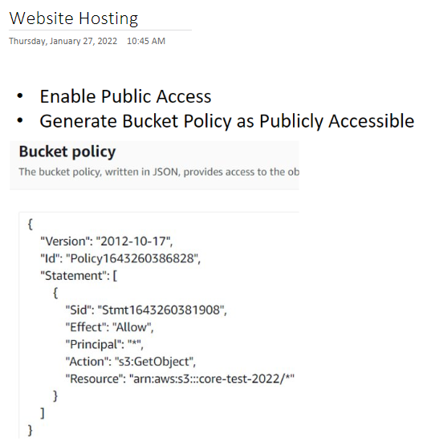

Slide 38
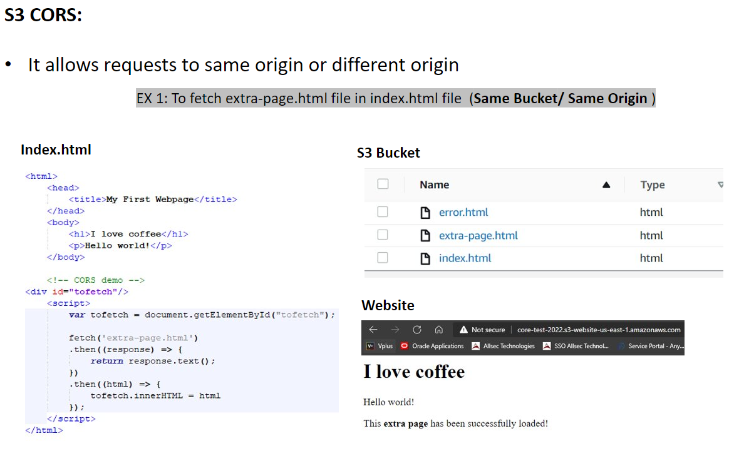

Slide 39
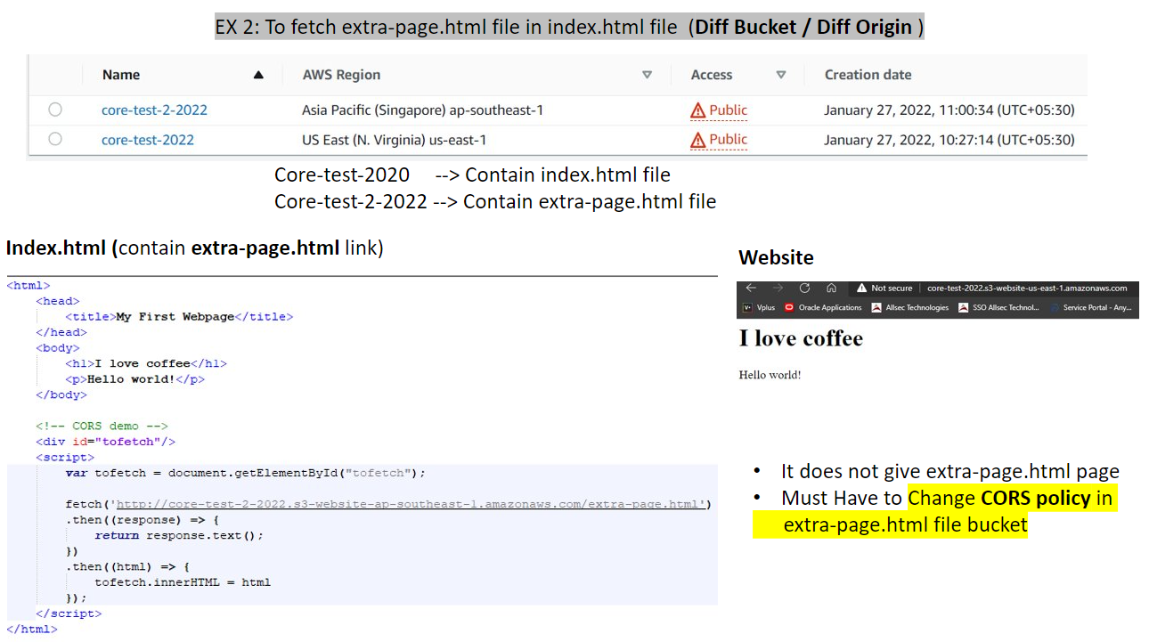

Slide 40
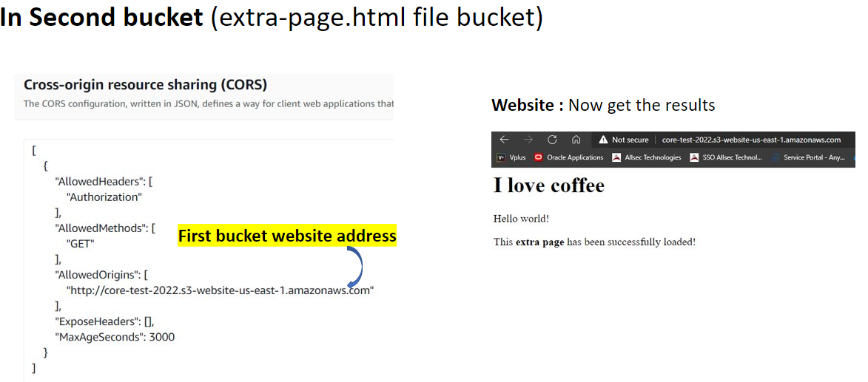

Slide 41
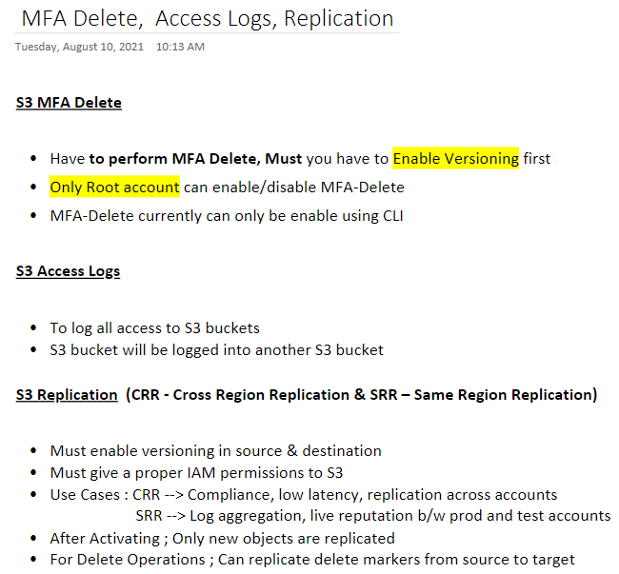

Slide 42
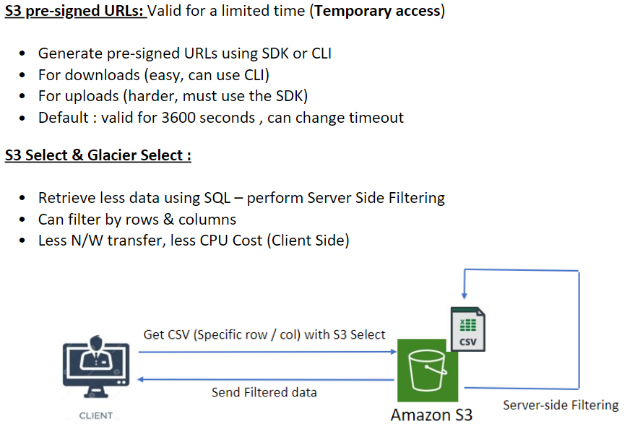

Slide 43
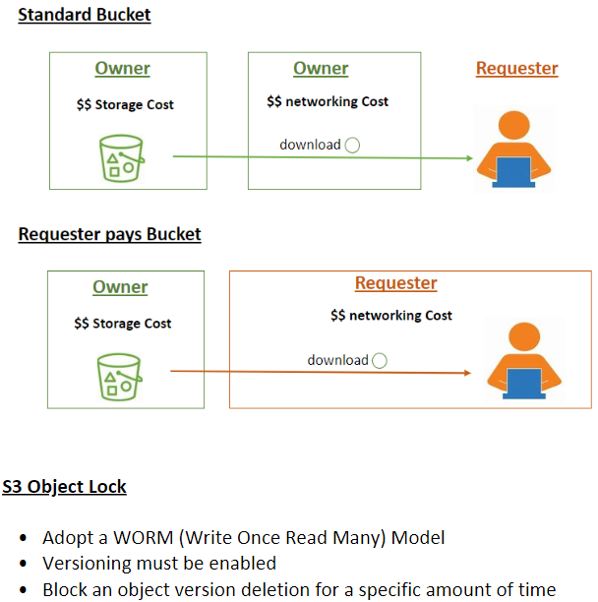

Slide 44
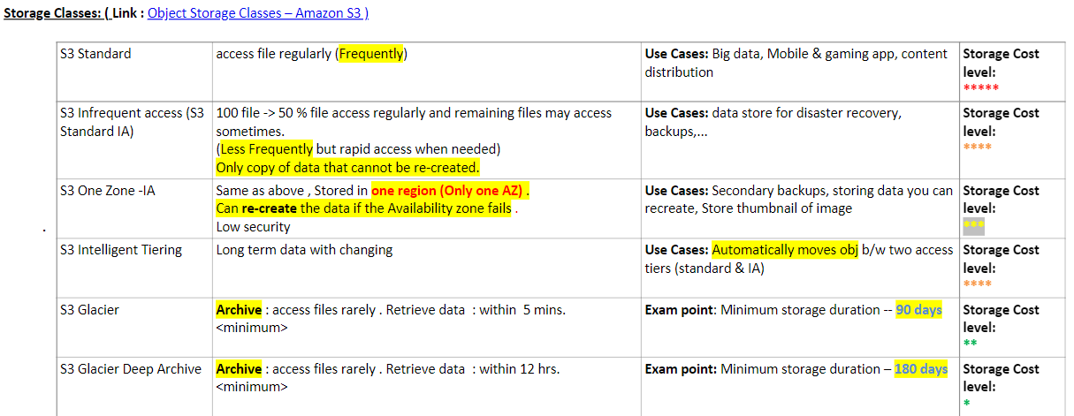

Slide 45
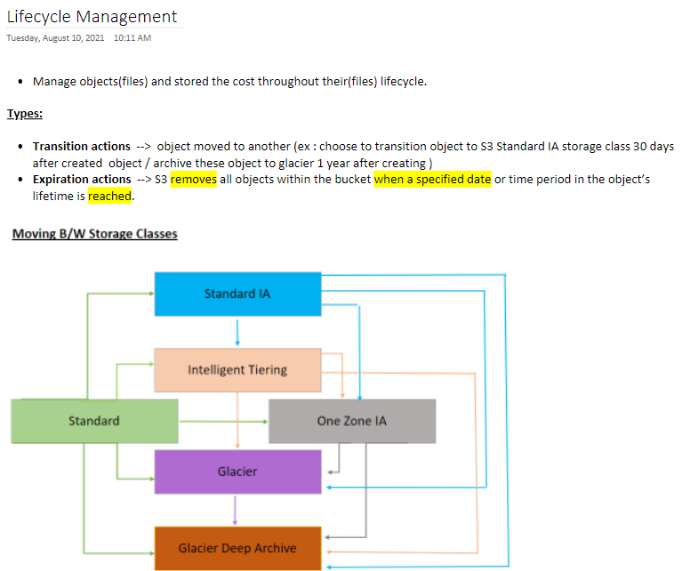

Slide 46
ROUTE 53

Slide 47
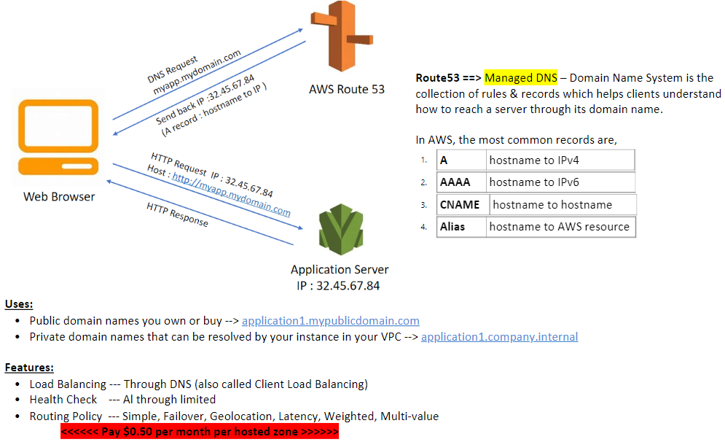

Slide 48


Slide 49


Slide 50



Slide 51


Slide 52
LAMBDA

Slide 53



Slide 54



Slide 55


Slide 56


Slide 57


Slide 58


Slide 59


Slide 60
CLOUDFRONT

Slide 61


Slide 62


Slide 63
SQS, SNS

Slide 64


Slide 65



Slide 66


Slide 67


Slide 68


Slide 69


Slide 70



Slide 71
DOCKER, ECS, ECR, EKS

Slide 72


Slide 73



Slide 74



Slide 75




Slide 76
ELASTIC BEANSTALK

Slide 77


